Slide 1
Simulation and Modeling
CSE4131_CSE4132

Slide 2
Time Series Forecasting
Time Series: A series of data points recorded at different time intervals. The interval can be sec, min, hour, day, month, or year.
Time Series forecasting is the process of using a statistical model to predict future values based on past results.
Forecasting a time series can be broadly divided into two types.
Univariate Time Series Forecasting.
Multi Variate Time Series Forecasting.

Slide 3
ARIMA Models
ARIMA (Autoregressive Integrated Moving Average Model) It is a forecasting algorithm based on the idea that the information in the past values of the time series can alone be used to predict the future values.
ARIMA Models are specified by three parameters: (p, d, q),
where,
p is the order of the AR term. It refers to the number of lags of Y to be used as predictors.
q is the order of the MA term.
d is the number of differencing. ARIMA work best when the predictors are not correlated and are independent of each other. So we need to make the time series stationary.

Slide 4
Types of ARIMA Model
ARIMA : Non-seasonal Autoregressive Integrated Moving Averages
SARIMA : Seasonal ARIMA
SARIMAX : Seasonal ARIMA with exogenous variables

Slide 5
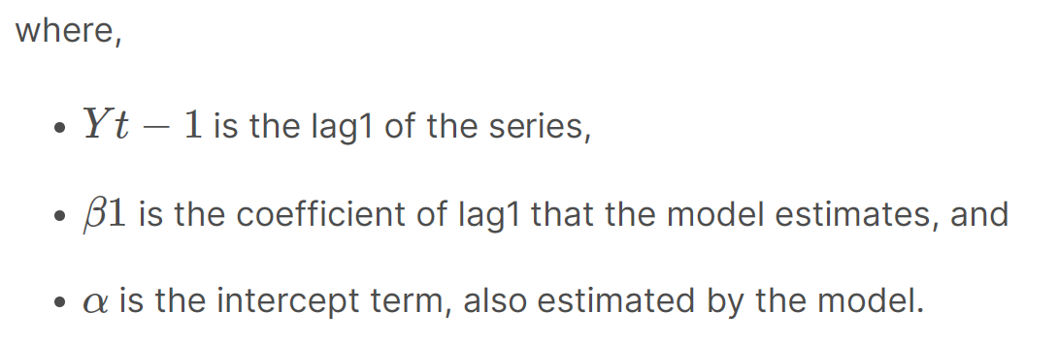
AR model is one where Yt depends only on its own lags.
Yt is a function of the lags of Yt.

Slide 6
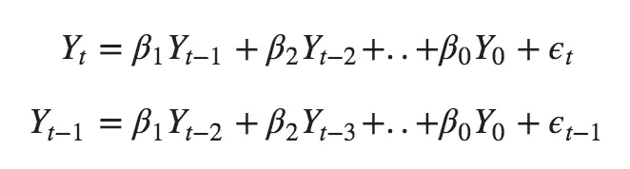
Auto
Moving Average (MA) model is one where Yt depends only on the lagged forecast errors.
where the error terms are the errors of the autoregressive models of the respective lags.
The errors Et and E(t-1) are the errors from the following equations :

Slide 7
Types of ARIMA Model
An ARIMA model is one where the time series was differenced at least once to make it stationary and we combine the AR and the MA terms. So the equation of an ARIMA model becomes :
ARIMA model in words:
Predicted Yt = Constant + Linear combination Lags of Y (upto p lags) + Linear Combination of Lagged forecast errors (upto q lags)

Slide 8
Order of Differencing (d) Calculation
ACF are positive for many number of lags (10 or more), then the series needs further differencing.
If the lag 1 autocorrelation itself is too negative, then the series is probably over-differenced.
Augmented Dickey Fuller test (ADF Test),
The null hypothesis (Ho) of the ADF test is that the time series is non-stationary.
So, if the p-value of the test is less than the significance level (0.05) then we reject the null hypothesis and infer that the time series is indeed stationary.

Slide 9
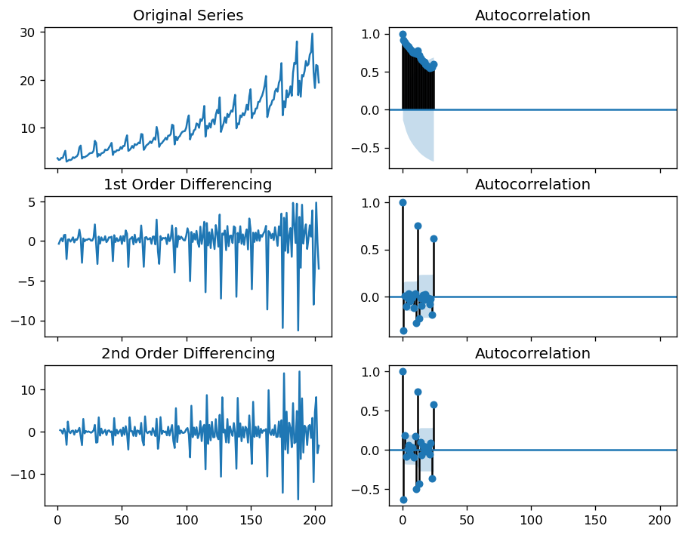
Series reaches stationarity with two orders of differencing.

Slide 10
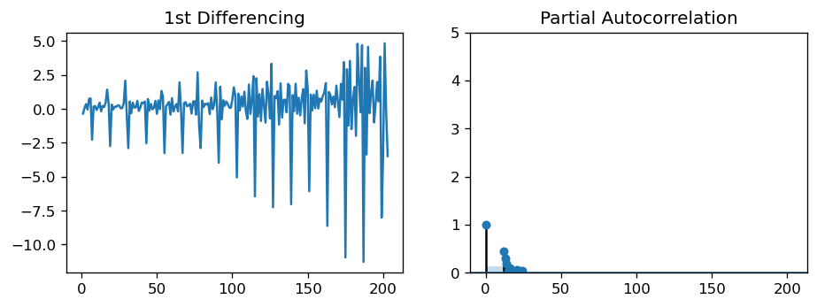
Partial Autocorrelation (PACF) plot.
The PACF lag 1 is quite significant since it is well above the significance line. So, we will fix the value of p as 1.

Slide 11
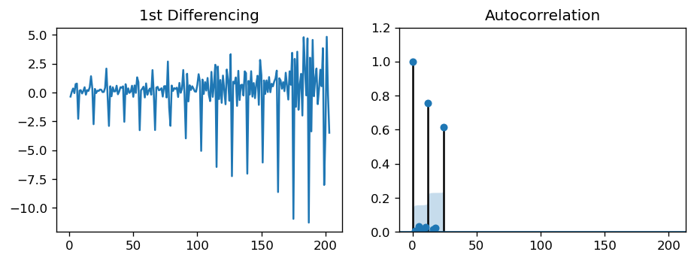
The order of the MA term (q)
ACF tells how many MA terms are required to remove any autocorrelation in the stationarized series.

Slide 14
Types of ARIMA Model
ARIMA Model for Time Series Forecasting | Kaggle

